Slide 1
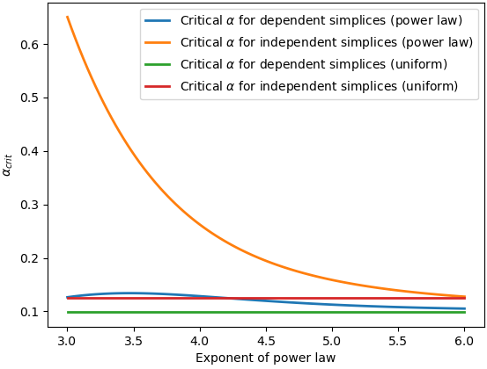
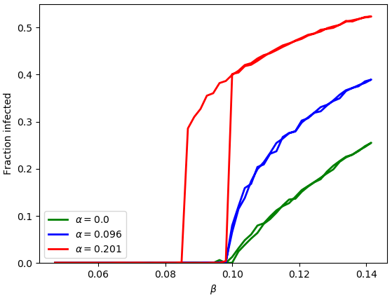
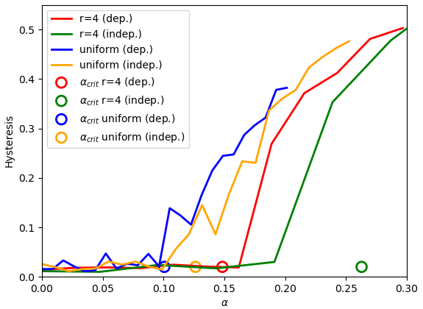

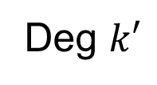

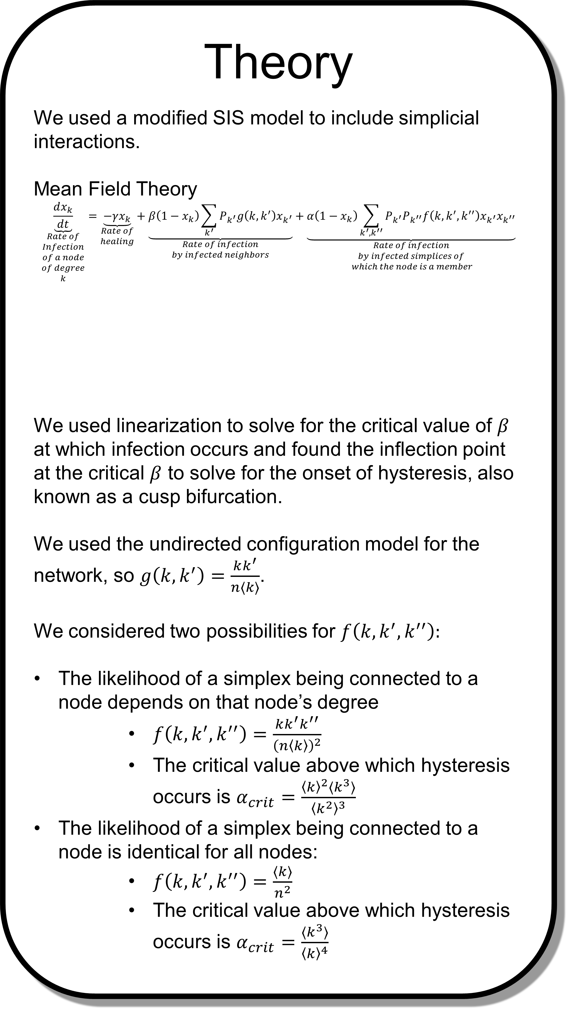

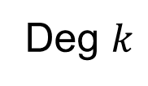


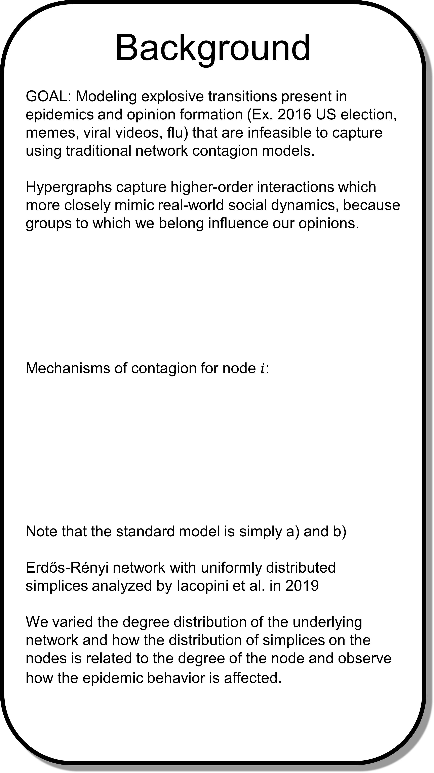








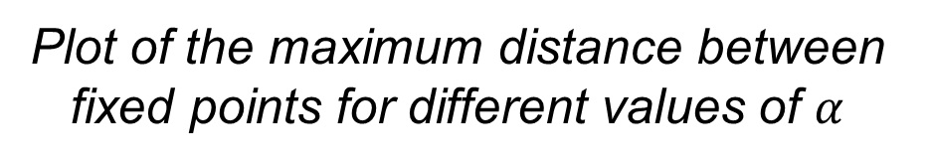

The effect of simplex and network degree distribution on simplicial contagion models
Nicholas Landry, Juan G. Restrepo, University of Colorado Boulder
Background
GOAL: Modeling explosive transitions present in epidemics and opinion formation (Ex. 2016 US election, memes, viral videos, flu) that are infeasible to capture using traditional network contagion models.
Hypergraphs capture higher-order interactions which more closely mimic real-world social dynamics, because groups to which we belong influence our opinions.
Mechanisms of contagion for node $i$:
Note that the standard model is simply a) and b)
Erdős-Rényi network with uniformly distributed simplices analyzed by Iacopini et al. in 2019
We varied the degree distribution of the underlying network and how the distribution of simplices on the nodes is related to the degree of the node and observe how the epidemic behavior is affected.
Theory
We used a modified SIS model to include simplicial interactions.
Mean Field Theory
$$\underset{\begin{aligned}Rate of \\ Infection \\ of a node \\ of degree \\ k\end{aligned}}{\underbrace{\frac{dx_{k}}{dt}}}=\underset{\begin{aligned}Rate of \\ healing\end{aligned}}{\underbrace{−γx_{k}}}+\underset{\begin{aligned}Rate of infection \\ by infected neighbors\end{aligned}}{\underbrace{β\left(1−x_{k}\right)\sum_{k^{′}}{P_{k^{′}}g\left(k,k^{′}\right)x_{k^{′}}}}}+\underset{\begin{aligned}Rate of infection \\ by infected simplices of \\ which the node is a member\end{aligned}}{\underbrace{α\left(1−x_{k}\right)\sum_{k^{′},k^{′′}}{P_{k^{′}}P_{k^{′′}}f\left(k,k^{′},k^{′′}\right)x_{k^{′}}x_{k^{′′}}}}}$$
We used linearization to solve for the critical value of $β$ at which infection occurs and found the inflection point at the critical $β$ to solve for the onset of hysteresis, also known as a cusp bifurcation.
We used the undirected configuration model for the network, so $g\left(k,k^{′}\right)=\frac{kk^{′}}{n⟨k⟩}$.
We considered two possibilities for $f\left(k,k^{′},k^{′′}\right):$
The likelihood of a simplex being connected to a node depends on that node’s degree
$f\left(k,k^{′},k^{′′}\right)=\frac{kk^{′}k^{′′}}{{\left(n\left\langle k\right\rangle \right)}^{2}}$
The critical value above which hysteresis occurs is $α_{crit}=\frac{{\left\langle k\right\rangle }^{2}⟨k^{3}⟩}{{\left\langle k^{2}\right\rangle }^{3}}$
The likelihood of a simplex being connected to a node is identical for all nodes:
$f\left(k,k^{′},k^{′′}\right)=\frac{⟨k⟩}{n^{2}}$
The critical value above which hysteresis occurs is $α_{crit}=\frac{⟨k^{3}⟩}{{\left\langle k\right\rangle }^{4}}$
Simulation
Degree distributions used:
Uniform degree distribution on $[10, 30]$
Truncated power law degree distribution with $r=4$ on $[13, 10000]$
$\left\langle k\right\rangle =20$ for both
$$f(k,k^{′},k′′)$$
Unstable
Onset of hysteresis as a function of the power in power law distribution
$$g(k,k^{′})$$
?
Stable
?
$$k$$
$$k′$$
$$α>α_{crit}$$
$$α>α_{crit}$$
Deg $k$
Deg $k′$
$$k′′$$
$$α<α_{crit}$$
$$α=α_{crit}$$
Network
Hypergraph
$$α<α_{crit}$$
$$γ$$
$$β$$
Simulation Infection Curves for uniform degree distribution and dependent simplices
Plot of the maximum distance between fixed points for different values of $α$
i
i
j
i
$$α$$
a) Individual healing
b) Infection from a friend
Conclusions
The network degree distribution strongly affects onset of hysteresis
Simplices distributed according to node degree dramatically lowers the onset of hysteresis when compared with uniformly distributed simplices
For networks with a highly heterogeneous degree distribution, explosive transitions can be suppressed by distributing the simplices independent of degree.
References
Iacopini, I., Petri, G., Barrat, A. et al. Simplicial models of social contagion. Nat Commun 10, 2485 (2019). doi:10.1038/s41467-019-10431-6
de Arruda, Guilherme Ferraz, Giovanni Petri, and Yamir Moreno. Social contagion models on hypergraphs. arXiv preprint arXiv:1909.11154 (2019).
Soriano-Paños, David, et al. Explosive transitions induced by interdependent contagion-consensus dynamics in multiplex networks. Physical Review E 99.6 (2019): 062311.
Healthy
Infected
c) Infection from a friend group

Slide 2
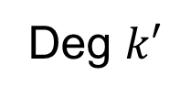


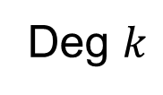








FINAL
Unstable
Stable
$$α>α_{crit}$$
$$α<α_{crit}$$
$$f(k,k^{′},k′′)$$
$$g(k,k^{′})$$
?
?
$$k$$
$$k′$$
$$γ$$
$$β$$
Deg $k$
Deg $k′$
$$k′′$$
i
i
j
i
$$α$$
a) Individual healing
b) Infection from a friend
Healthy
Infected
c) Infection from a friend group

Slide 3
FINAL

Slide 4





$$f_{2}(k,k^{′})$$
$$f_{3}(k,k^{′},k′′)$$
Deg $k$
Deg $k′$
$$k$$
$$k′$$
$$k′′$$

Slide 5
FINAL
Degree-Correlated
Uncorrelated
Degree-correlated
Uncorrelated

Slide 6




FINAL
$$β_{3}$$
$$β_{3}$$
$$β_{2}$$
$$β_{2}$$

Slide 7


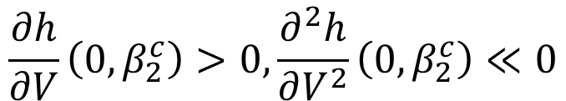
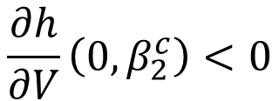
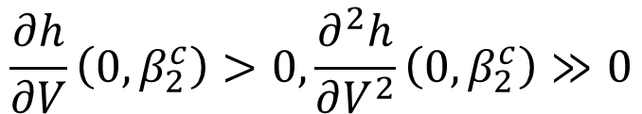
$$h(V,β_{2})$$
$$V$$
$$\frac{∂h}{∂V}\left(0,β_{2}^{c}\right)>0, \frac{∂^{2}h}{∂V^{2}}\left(0,β_{2}^{c}\right)≫0$$
$$\frac{∂h}{∂V}\left(0,β_{2}^{c}\right)<0$$
$$\frac{∂h}{∂V}\left(0,β_{2}^{c}\right)>0, \frac{∂^{2}h}{∂V^{2}}\left(0,β_{2}^{c}\right)≪0$$

Slide 8





$$U$$
$$β_{3}>β_{3}^{c}$$
$${B(β}_{3})$$
$$β_{2}^{c}$$
$$β_{2}$$

